Slide 1
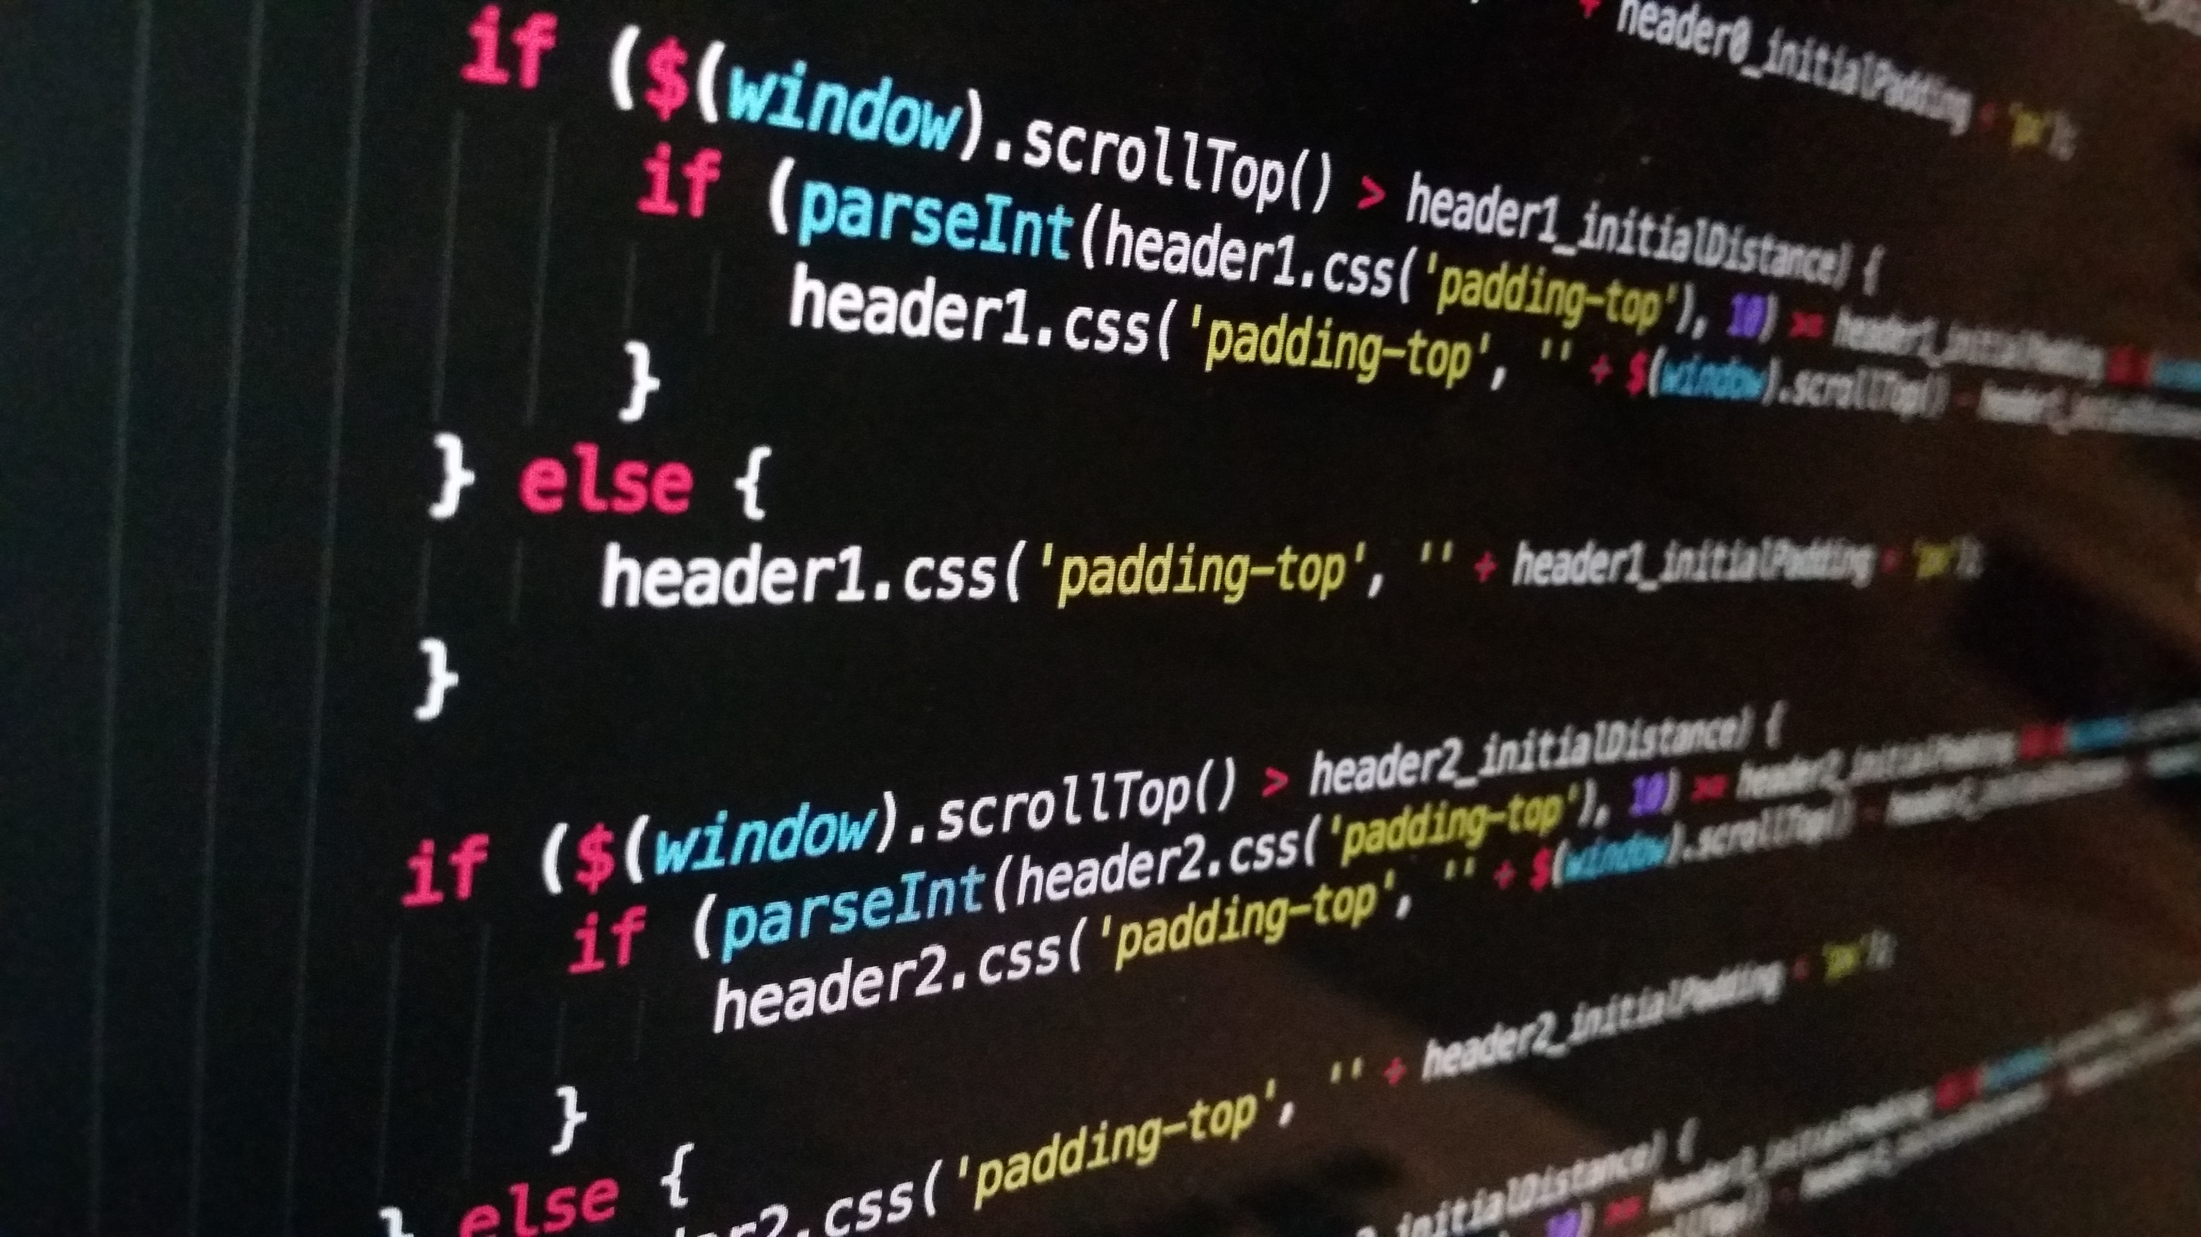
PRESENTATION ON Node.js
By 22101A2004- NIRAJ JADHAV

Slide 2
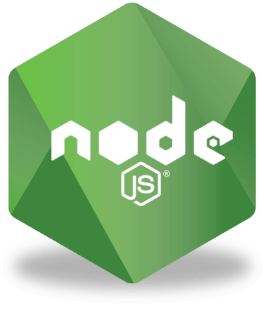
Introduction to Node.js
Node.js is an open-source, cross-platform runtime environment used for the development of server-side web applications. Node.js applications are written in JavaScript and can be run on a wide variety of operating systems.
Node.js is based on an event-driven architecture and a non-blocking Input/Output API that is designed to optimize an application’s throughput and scalability for real-time web applications.
Node.js was created by Ryan Dahl in 2009. It was initially built to handle I/O operations in a non-blocking, efficient way.

Slide 3

Node.js Architecture
Node.js is built on a unique architecture that makes it different from traditional server-side environments. Node.js is based on an event-driven, non-blocking I/O model. It is designed to be single-threaded but highly scalable.
Event-Driven Model
Node.js is event-driven, meaning it responds to events like incoming requests and data, rather than following a sequential flow.
This model allows Node.js to efficiently manage multiple concurrent tasks.

Slide 4
Node.js Architecture
Non-blocking I/O
Node.js uses non-blocking I/O operations to avoid waiting for data to be read or written.
While one operation is in progress, Node.js can execute other tasks without blocking the execution thread.
Single-Threaded Event Loop
Node.js employs a single-threaded event loop, which is at the core of its architecture.
The event loop is responsible for executing I/O operations and event callbacks.

Slide 5

Features of Node.js
Asynchronous and Non-blocking: Node.js can execute multiple operations simultaneously without blocking the execution of other tasks..
Cross-Platform: Node.js is available on various operating systems, making it versatile and widely adopted.
Fast Execution: Known for its fast execution due to its event-driven, non-blocking architecture.

Slide 6
Components of Node.js
Node Package Manager (npm): npm is the default package manager for Node.js, used to install, manage, and share JavaScript packages and libraries.
Modules and require(): Node.js uses a module system for organizing code into reusable components, and is the method to include and use these modules in your code.
Event Loop: The event loop is the core of Node.js, responsible for managing asynchronous tasks and event-driven operations without blocking the main thread.
Callbacks: Callbacks are functions passed as arguments to other functions, allowing for asynchronous control flow and defining actions to be executed when an asynchronous operation is completed.
Event Emitters: Event Emitters in Node.js allow you to create and handle custom events, enabling event-driven programming and communication between different parts of your application.
Streams: Streams in Node.js provide a way to efficiently read and write data, making it suitable for handling I/O-intensive tasks by processing data in small, manageable chunks.

Slide 7
Real Life Use Cases of Node.js
Web Servers and APIs: Node.js is commonly used to build fast and scalable web servers and RESTful APIs, such as those used in social media platforms.
Microservices Architecture: Node.js is ideal for creating microservices due to its lightweight and efficient nature, making it a popular choice in cloud-based and distributed systems.
Real-time Applications: Node.js is employed in applications requiring real-time features, like chat applications, online gaming, and collaborative tools.
Desktop Applications (Electron): Node.js, through the Electron framework, allows developers to create cross-platform desktop applications using web technologies.
Cross-Platform Mobile Applications (React Native): Node.js is integrated into React Native to enable the development of cross-platform mobile apps using JavaScript for both iOS and Android.

Slide 8

WHERE TO USE Node.js
Game servers – Fast and high-performance servers that need to processes thousands of requests at a time, then this is an ideal framework.
Good for collaborative environment – This is good for environments which manage documents.
Streaming servers – Another ideal scenario to use Node is for multimedia streaming servers wherein clients have request’s to pull different multimedia contents from this server.

Slide 9
Challenges & Best Practices of Using Node.js
Challenges
Callback Hell: Managing nested callbacks can lead to complex and hard-to-maintain code.
Blocking Operations: CPU-intensive tasks can block the event loop, impacting application responsiveness.
Best Practices
Modular Code: Organize code into modular components for better maintainability and reusability.
Error Handling: Implement robust error handling to prevent unhandled exceptions from crashing your application.
Monitoring and Profiling: Use monitoring and profiling tools to identify performance bottlenecks and optimize your application.
Version Management: Use a version manager like nvm to manage Node.js versions and ensure compatibility with your application.
Load Balancing: Employ load balancing to distribute incoming requests across multiple Node.js instances for scalability.

Slide 10
THANK YOU

